Slide 1
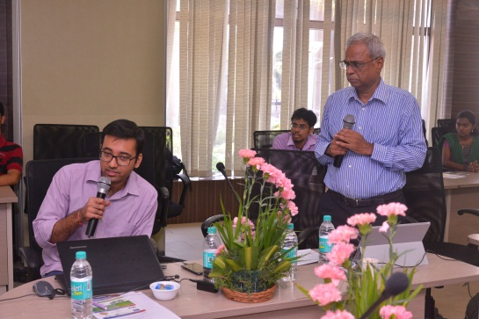
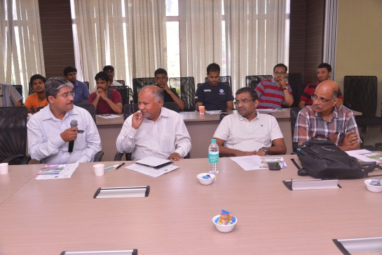
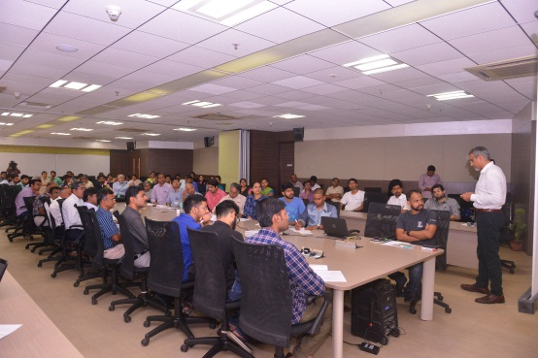




Brainstorm to Build Domain-Specific Startups | An IITM Impact Workshop Series
Event Report
Gaining entrepreneurial insights into specific domain areas
Partners
Edition II: Electric Vehicles

Slide 2
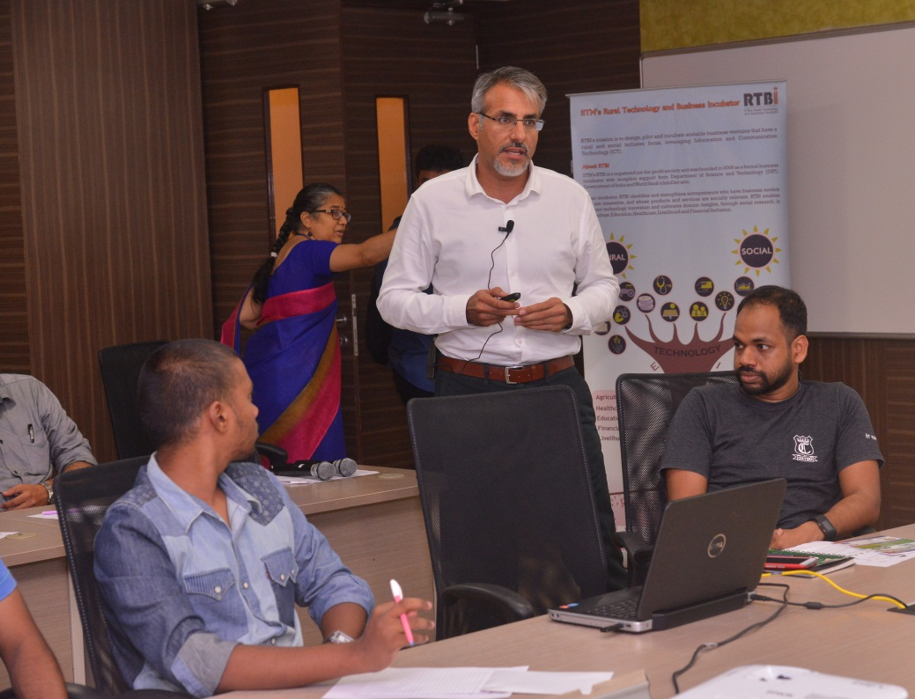



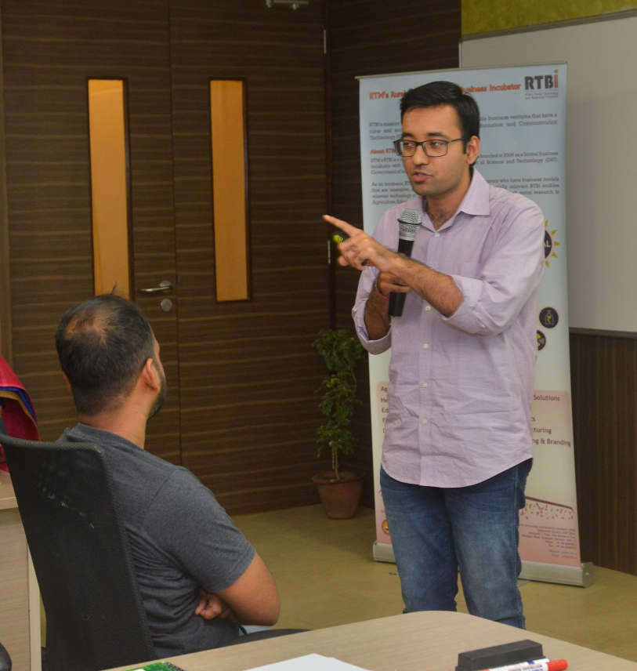
Brainstorm to Build Domain-Specific Startups | An IITM Impact Workshop Series
Edition II: Electric Vehicles
When?
Where?
1st October, 2016
Between 9:30 am to 1:30pm
IIT Madras Research Park
Taramani, Chennai
Who?
Total participants including faculties of IIT Madras, domain experts, entrepreneurs, students and research scholars– 120+
Brainstorming On -
Technology challenges in Electric Vehicles (EV)
R&D required for electric vehicles
The economics and the market for EV

Slide 3
Event Agenda
Overview of the programme by
Prof. Ashok Jhunjhunwala
9:45 am – 10:15 am
Presentation by Mr. Chetan Maini
10:15 am – 10:40 pm
10:40 pm – 11:05 pm
Presentation by Mr. Tarun Mehta
Presentation by Prof. Ashok Jhunjhunwala
11:05 pm – 11:30 pm
Brainstorming Session moderated by Prof. Ashok Jhunjunwala
11:30 pm – 1:00 pm
Concluding remarks by
Dr. Tamaswati Ghosh (IITM IC)

Slide 4
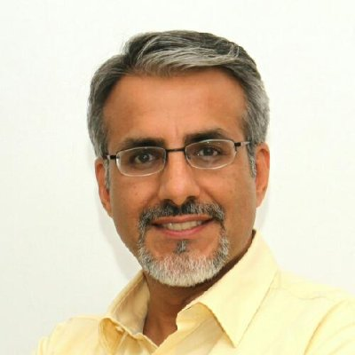
Presentations
1
Mr. Chetan Maini,
Founder and Advisor of Mahindra Reva Electric Vehicle Co Ltd.
Spoke about the changing landscape of electric vehicle domain of automobile industry
Helped the participants visualize the future of electric vehicles through interactive graphs and animations
Covered almost all aspects of the electric vehicles -- product life cycle, infrastructure requirement, political and economic environment, business potential and sustainabillity

Slide 5
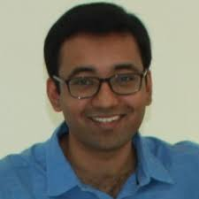
Presentations
2
Mr. Tarun Mehta
Co-Founder and Chief Executive Officer, Ather Energy
Shared his experience with his startup in EV domain – Ather Energy
Highlighted manufacturing challenges, human resource challenges, technological challenges and financial challenges.
Reiterated the need for a ecosystem approach to understand and address the electric vehicle domain.

Slide 6
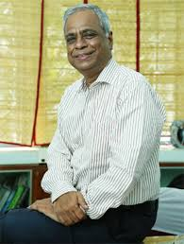
Presentations
3
Prof. Ashok Jhunjhunwala,
Professor in the Dept. of Electrical Engineering, IIT Madras.
Provided the rationale for moving to EV from fossil fuel run vehicles
Explained the landscape covering Government- Automobile industry- Electric vehicle domain
Specified the areas where R&D is required
Spoke about the future of electric vehicles in Indian context
Highlighted the entrepreneurial opportunities in electric vehicles domain (Electric Vehicle manufacturing, auto components, battery technology, charging infrastructure)

Slide 7
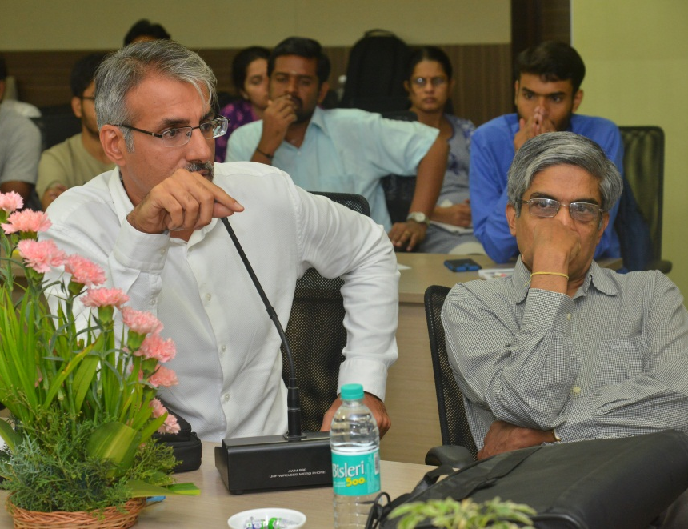
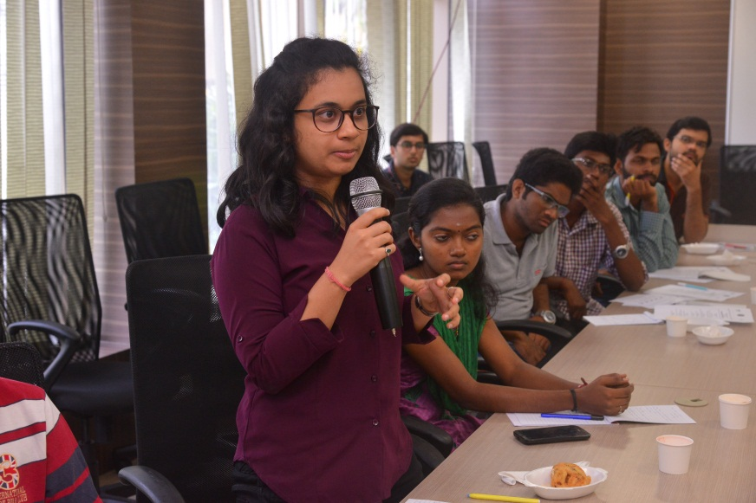
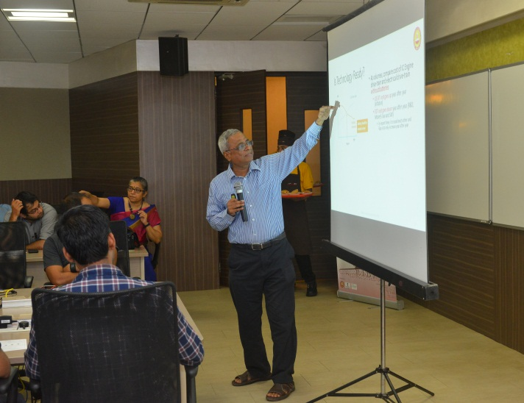
Brainstorming – Key Highlights
Panel: Mr. Chetan Maini, Mr. Tarun Mehta and all the participants
Moderated by Prof. Ashok Jhunjhunwala (IIT Madras)
Key Discussion Points
Challenges in Electric vehicle domain and future prospects in this domain
Various Dimensions of electric vehicle domain (Example: charging infrastructure, battery swapping technology, battery reuse technology, clean energy for charging EVs, sustainability aspects, political and social dimensions, subsidies, etc.,
Entrepreneurial opportunities in EV, R&D, product development, future scope, their respective challenges

Slide 8
Brainstorming – Summary Points
1
How to address the problem of charging infrastructure for electric vehicles?
Based on the charging requirements of the different types of customer segments, the charging options can be created. Eg: fast emergency charging and slow charging individual owners as well as battery swap technology for taxis. The business innovations will arise, if the scale of electric vehicles increases.
2
Considering the price difference between conventional and electric vehicles, what is the market segment that can be targeted?
A small prepared market (paying capacity, environmental concerns) can be targeted. Once, the overall benefit to cost ratio improves, it can be scaled up.
3
What are the issues with respect to servicing of the vehicles?
Diagnostic capacities of the service providers must be improved and a different kind of servicing infrastructure is needed. EVs need less periodical maintenance when compared to conventional vehicles.
4
What are some of the difficulties faced by REWA initially?
Team formation, regulation issues, financial constraints, supply chain issues.
5
What are the HR issues that exist in India with respect to EVs?
Suitable talent is scarce in India. At College level, doing projects related to EVs will help students to prepare for the requirements of the EV domain. Design culture should be established among the human resources.
Note: Distilled points are covered in the report. You can view the presentations and the interactions in their entirety here .

Slide 9
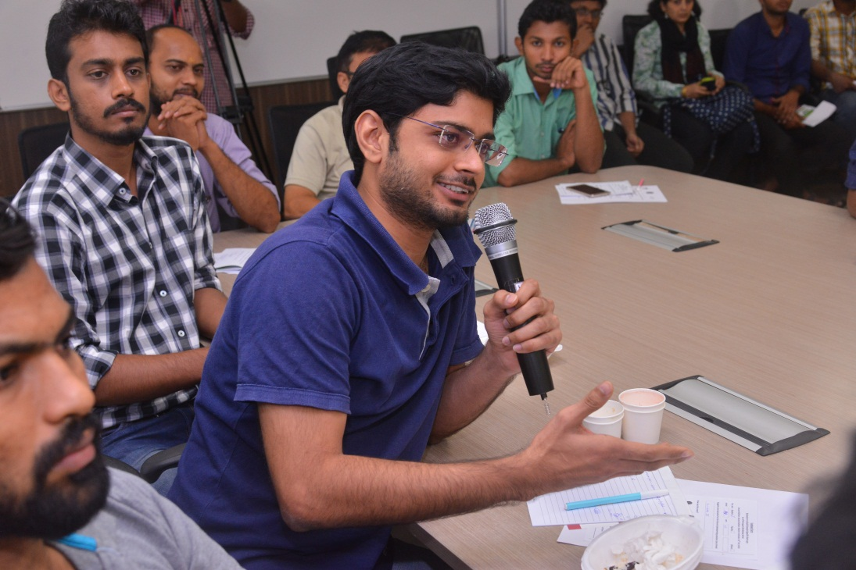
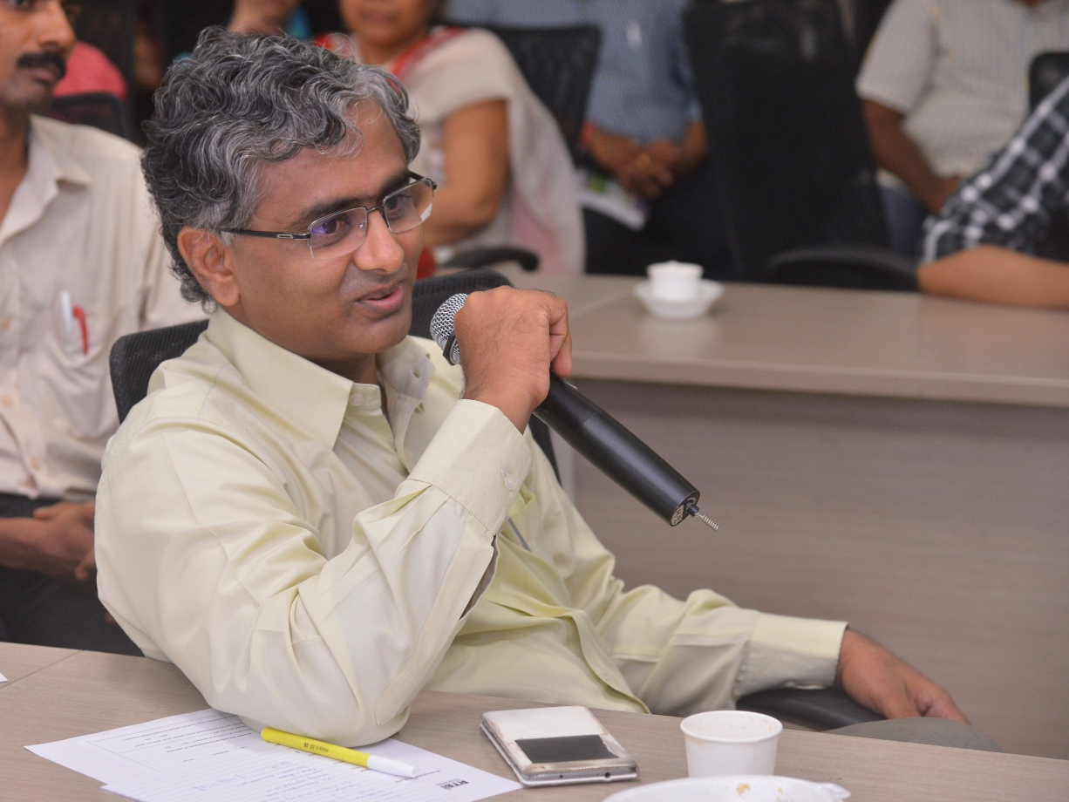
Stay tuned
3
Upcoming Editions | Agri-Tech
4
Upcoming Editions | Waste Management

Slide 10
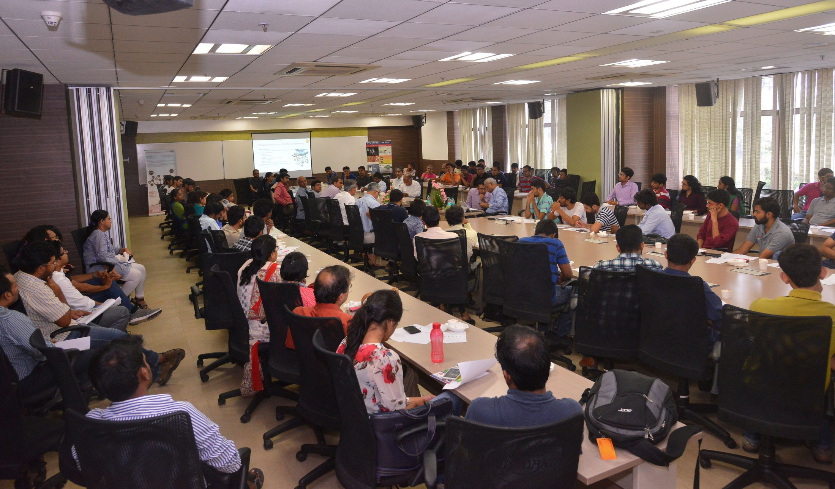
For further details,
Contact:
RTBI, Module#6, I Floor IITM Research Park, Kanagam Road,
Tharamani, Chennai 600 113
P: +91 44 66469872
Email: info@rtbi.in

