Slide 1
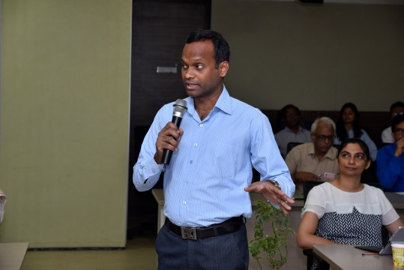
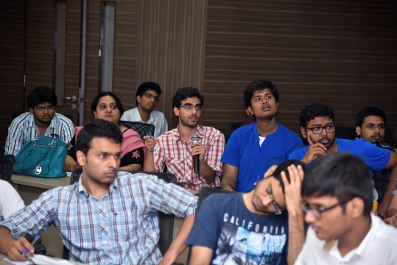
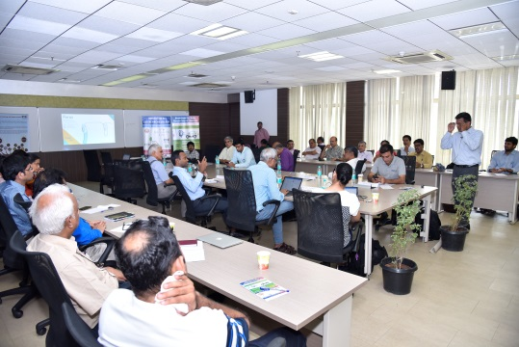




Brainstorm to Build Domain-Specific Startups | An IITM Impact Workshop Series
Event Report
Gaining entrepreneurial insights into specific domain areas
Partner
Edition I: Medical Devices

Slide 2
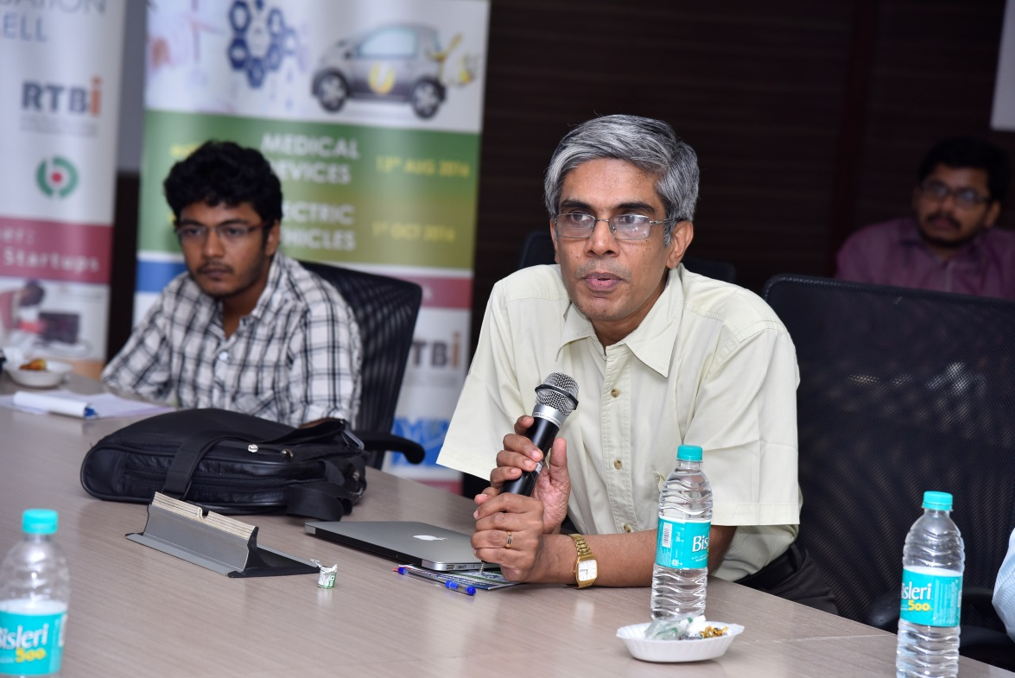



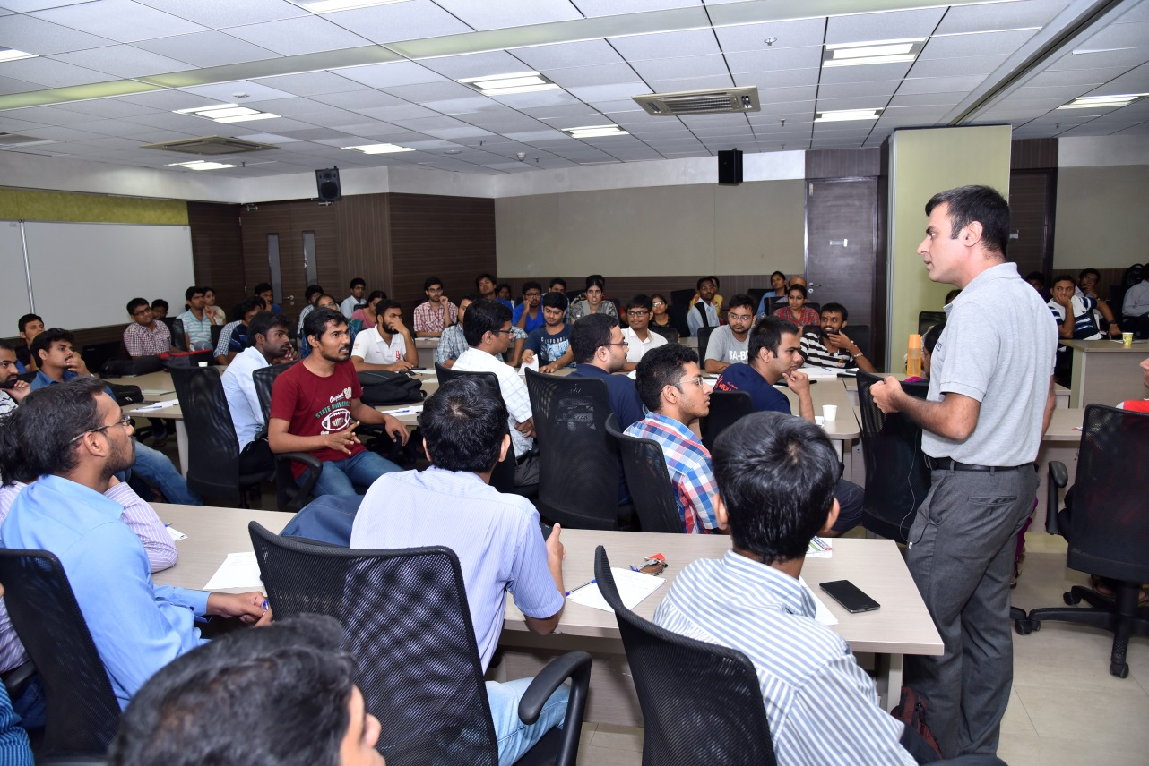
Brainstorm to Build Domain-Specific Startups | An IITM Impact Workshop Series
Edition I: Medical Devices
When?
Where?
13th August, 2016
Between 9:30 am to 1:30pm
IIT Madras Research Park
Taramani, Chennai
Who?
Total participants including faculties of IIT Madras, domain experts, entrepreneurs, students and research scholars– 120+
Brainstorming On -
1. Working of the med-tech market
Barriers, Gaps & Bottlenecks.
2. Different product categories and market segments
Needs and opportunities.
3. Economics of R&D, manufacturing, marketing, sales and service
Industry perspective.
4. Cost of ownership, revenues and maintenance
Customer perspective.
5. Areas ripe for entrepreneurship

Slide 3
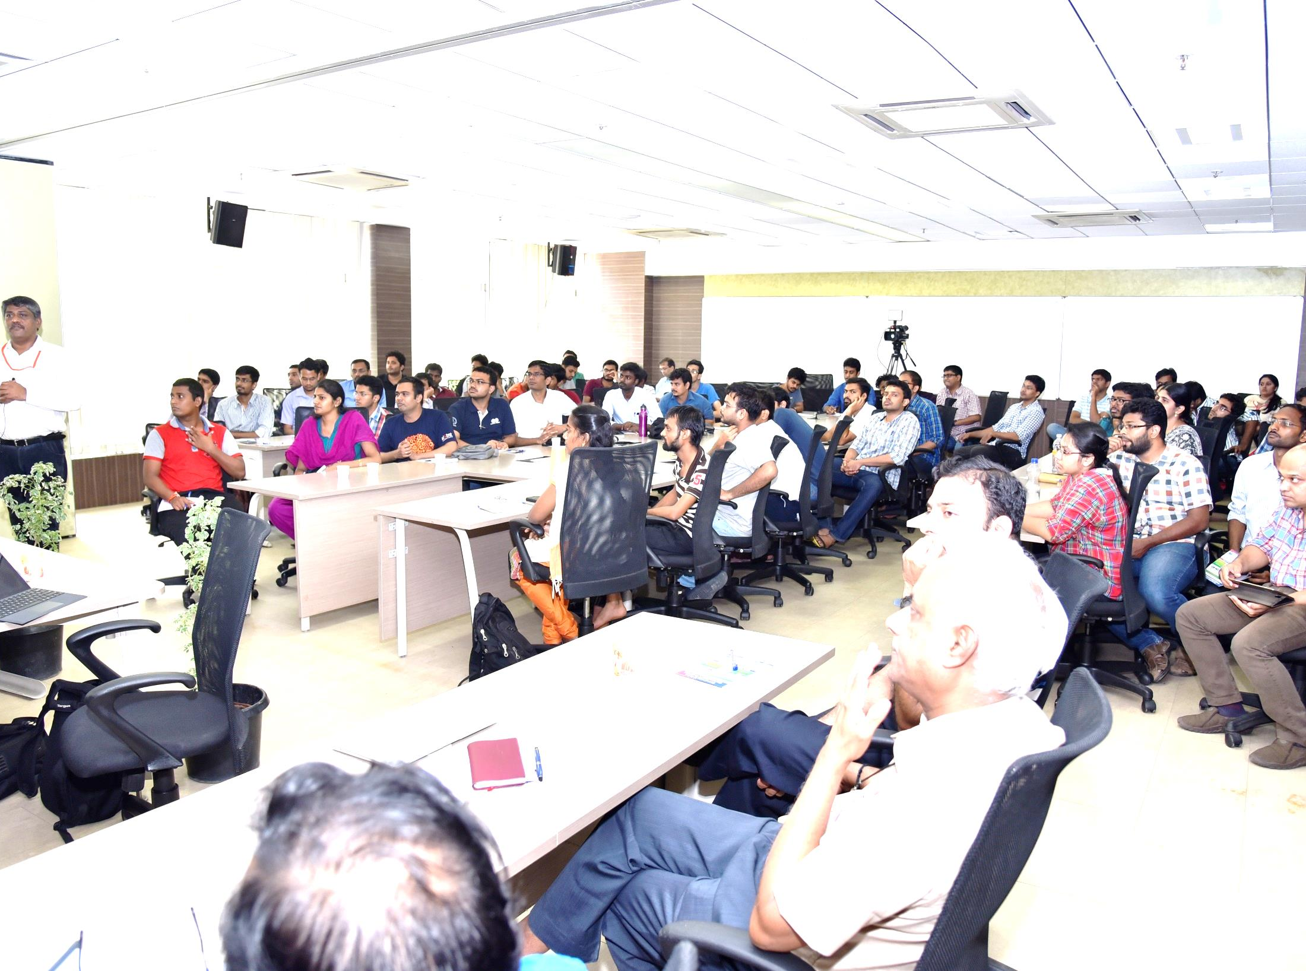
Event Agenda
Context setting for the series
Prof. Ashok Jhunjhunwala
9:45 am – 10:00 am
Context setting for the Workshop
Dr. Mohanasankar
All attendees were involved in the discussion. Participants were invited to ask questions, add knowledge and share opinions.
10:00 am – 10:15pm
10:15 pm – 12:0 0pm
Presentation by domain experts and entrepreneurs
Brainstorming
12:00 pm – 1:15 pm
Conclusion
1:15 pm – 1:30 pm

Slide 4
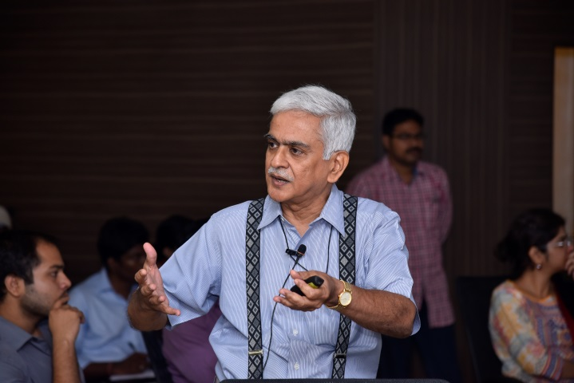
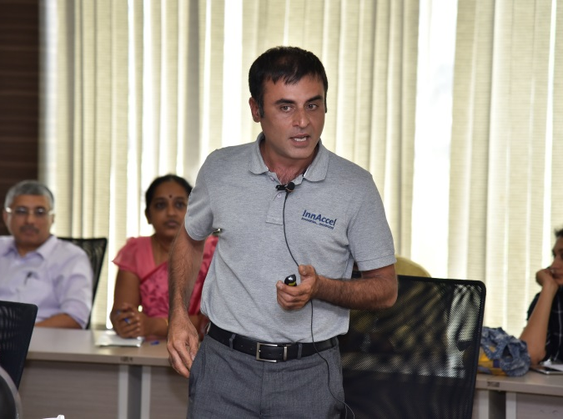
Presentations
1
‘Indian Healthcare & Medical Devices Industry : Opportunities’
Dr. G.S. Bhuvaneshwar (Consultant-Medical devices)
Gave a broad overview of the health care sector market by giving specific emphasis on Medical-devices market.
He presented the problems in the healthcare sector from the aspect of demand & supply mismatch, subsector insights, policy level issues, target market specific details, innovation and research gaps, etc.,
2
‘MedTech Innovation & Entrepreneurship’
Mr. Siraj Dhanani (Founder & CEO, InnAccel),
He drew the attention of the listeners by presenting product specific differences and case studies of two of InnAccel’s products.
He also revealed InnAccel’s methodology of ‘opportunity identification’ and idea validation in medical devices sub-sector.

Slide 5
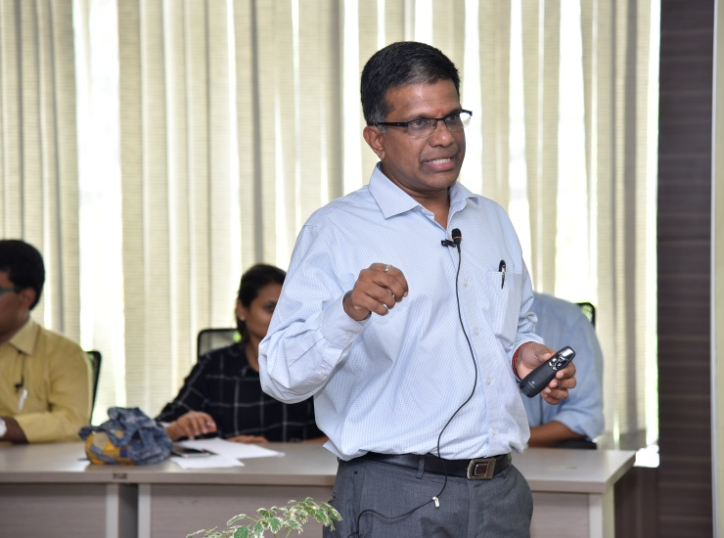
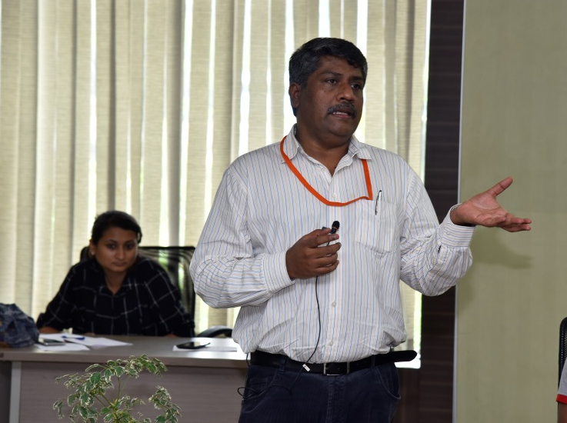
Presentations
3
‘Forus: One goal- prevent avoidable blindness’
Mr. K. Chandrasekhar (Founder & CEO, Forus Health)
Demonstrated the products of Forus, the innovations behind those products, the scale of impact which the products are making, etc
Major focus was given to the diagnostic medical devices and its’ role in preventive healthcare.
4
‘Enabling Image Guided Interventional Therapies’
Mr. Nandakumar (Co-Founder & CEO, Perfint)
Emphasized on the opportunities in interventional therapies.
He used the case study of two products of Perfint, ROBIO and MAXIO to explain the product development process, complexities in developing a product for interventional therapies and its difference from diagnostic medical devices.

Slide 6
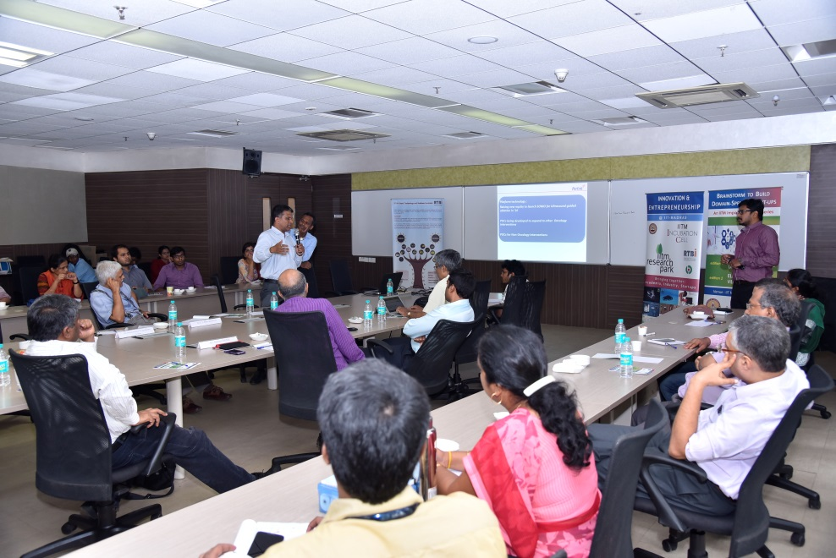
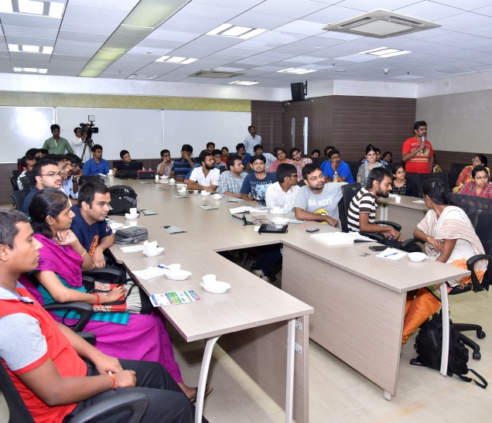
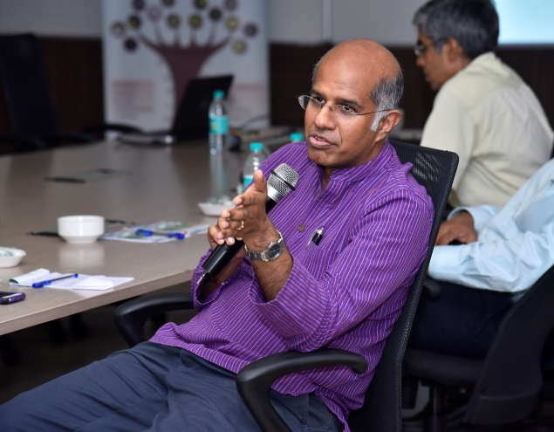
Brainstorming – Key Highlights
Panel: Dr. G.S. Bhuvaneshwar, Mr. Siraj Dhanani (InnAccel), Mr. K. Chandrasekhar (Forus Health), Mr. S. Nandakumar (Perfint), Mr. Sameer Mehta (Dr Mehta's Hospitals), Prof. Bhaskar Ramamurthi (Director, IIT Madras), Prof. Ashok Jhunjhunwala (IIT Madras).
Moderated by Dr. Mohanasankar Sivaprakasam (IIT Madras)
Key Discussion Points
India specific challenges and gaps in the Med-tech domain of Health care sector
Varying needs of primary, secondary and tertiary sectors in healthcare
Entrepreneurial opportunities of diagnostic, therapeutic and theranostic devices in terms of problem identification, product development & business modelling; their respective challenges

Slide 7
Brainstorming – Summary Points
Is there a network that exists specifically for Medical devices sector?
1
Right now, in India, the medical devices market is highly fragmented and no large scale networking platform exist. But in most cases, at the initial stage of product validation, finding a few potential clients is more important than looking for a networking platform. Also, it is very important for startups to work closely with clinicians to understand the exact nature of problems and tune their product accordingly.
2
Who will assist startups in their R&D activities?
In the initial stages, the entrepreneur needs to rely on the facilities of relevant institutions and leverage suitable grant funding schemes of government agencies. Gradually they can explore other avenues to carry out R & D activities.
3
What is the scope of medical devices in veterinary science field?
There is immense scope for medical devices in veterinary science field but unfortunately it is a highly unattended market. This is still an untapped market for entrepreneurial opportunities
What is the status of India in terms of availability of hardware devices which will be used in the medical devices?
4
Here the difference between place design of devices and manufacturing of devices should be understood. The strategy should be more focused on quality designing than just manufacturing
5
What are the regulatory hurdles in the medical devices sector?
Regulatory issues exist and processes are continuously evolving. It is essential for entrepreneurs to have a basic understanding about the current regulatory stands to avoid conflicts.
Note: Select discussions are covered in the report. You can view the presentations and the interactions in their entirety here .

Slide 8
Stay tuned
2
Edition 2
October 1, 2016 | Electric Vehicles
3
Upcoming Editions | Agri-Tech
4
Upcoming Editions | Waste Management

Slide 9
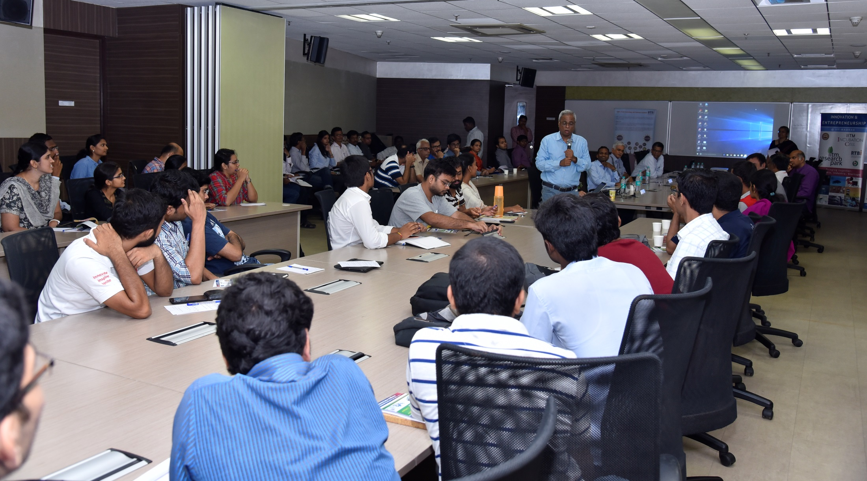
For further details,
Contact:
RTBI, Module#6, I Floor IITM Research Park, Kanagam Road,
Tharamani, Chennai 600 113
P: +91 44 66469872
Email: info@rtbi.in

